Slide 1
SS ZG 526: Distributed Computing
Oral Message Algorithm
Chittaranjan Hota
Professor, Dept. of Computer Sc. & Information Systems
BITS, Pilani Hyderabad Campus, Hyderabad
hota@hyderabad.bits-pilani.ac.in

Slide 2

Byzantine Agreement: Impossibility condition
Theorem: There is no algorithm to solve byzantine if only oral messages are used, unless more than two thirds of the generals are loyal.
In other words, impossible if n ≤ 3f for n processes, f of which are faulty
Oral messages are under control of the sender
  sender can alter a message that it received before forwarding it
Let’s look at examples for special case of n=3, f=1
Birla Institute of Technology and Science, Pilani (Deemed University)

Slide 3

Case 1
Traitor lieutenant tries to foil consensus by refusing to participate
“white hats” == loyal or “good guys”
“black hats” == traitor or “bad guys”
Round 1: Commanding
General sends “Retreat”
Commanding General 1
Round 2: L3 sends “Retreat” to L2, but L2 sends nothing
Loyal lieutenant obeys
commander. (good)
R
R
Decide: L3 decides “Retreat”
Lieutenant 3
Lieutenant 2
R
decides to retreat
Acknowledgement: Class lectures of A.D Brown of UofT
Birla Institute of Technology and Science, Pilani (Deemed University)

Slide 4

Case 2a
Traitor lieutenant tries to foil consensus by lying about order sent by general
Round 1: Commanding
General sends “Retreat”
Commanding General 1
Round 2: L3 sends “Retreat” to L2; L2 sends “Attack” to L3
Loyal lieutenant obeys
commander. (good)
R
R
Decide: L3 decides “Retreat”
Lieutenant 3
Lieutenant 2
R
decides to retreat
A
Acknowledgement: Class lectures of A.D Brown of UofT
Birla Institute of Technology and Science, Pilani (Deemed University)

Slide 5

Case 2b
Traitor lieutenant tries to foil consensus by lying about order sent by general
Round 1: Commanding
General sends “Attack”
Commanding General 1
Round 2: L3 sends “Attack” to L2; L2 sends “Retreat” to L3
Loyal lieutenant disobeys
commander. (bad)
A
A
Decide: L3 decides “Retreat”
Lieutenant 3
Lieutenant 2
A
decides to retreat
R
Acknowledgement: Class lectures of A.D Brown of UofT
Birla Institute of Technology and Science, Pilani (Deemed University)

Slide 6

Case 3
Traitor General tries to foil consensus by sending different orders to loyal lieutenants
Round 1: General sends “Attack” to L2 and “Retreat” to L3
Commanding General 1
Round 2: L3 sends “Retreat” to L2; L2 sends “Attack” to L3
Loyal lieutenants obey
commander. (good)
Decide differently (bad)
Decide: L2 decides “Attack” and L3 decides “Retreat”
A
R
Lieutenant 3
Lieutenant 2
R
decides to retreat
decides to attack
A
Acknowledgement: Class lectures of A.D Brown of UofT
Birla Institute of Technology and Science, Pilani (Deemed University)

Slide 7

Oral Message Algorithm
Oral Message algorithm, OM(m) consists of m+1 “phases”
Algorithm OM(0) is the “base case” (no faults)
  Commander sends value to every lieutenant
  Each lieutenant uses value received from commander, or default “retreat” if no value was received
Recursive algorithm OM(m) handles up to m faults
Commander sends value to every lieutenant
For each lieutenant i, let v_{i} be the value i received from commander, or “retreat” if no value was received. Lieutenant i acts as commander and runs Alg OM(m-1) to send v_{i} to each of the n-2 other lieutenants
For each i, and each j not equal to i, let v_{j} be the value Lieutenant i received from Lieutenant j in step (2) (using Alg OM(m-1)), or else “retreat” if no such value was received. Lieutenant i uses the value majority(v₁, … , v_{n-1}) to compute the agreed upon value.
Birla Institute of Technology and Science, Pilani (Deemed University)

Slide 8
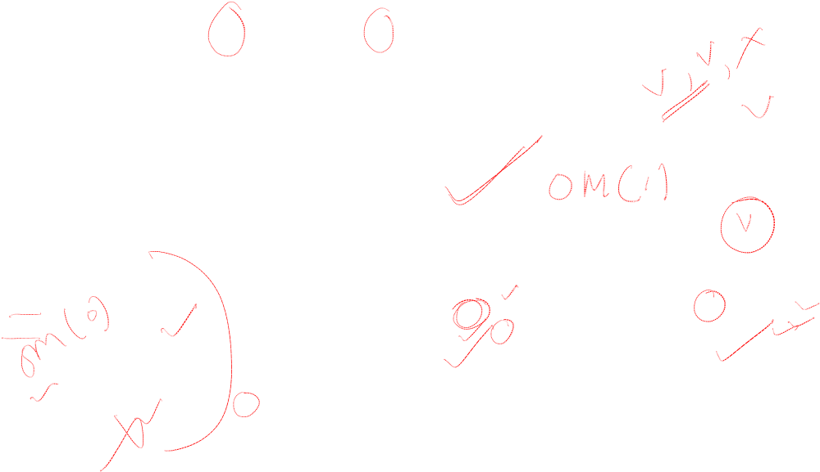
Example OM with m=1, and n=4
Step 1: Commander sends same value, v, to all
Commander 1
Step 2: Each of L2, L3, L4 executes OM(0) as commander, but L2 sends arbitrary values
v
v
v
Step 3: Decide
L3 has {v,v,x},
L4 has {v,v,y},
Both choose v.
v
v
x
v
L2
L3
L4
v
y
Birla Institute of Technology and Science, Pilani (Deemed University)

Slide 9

Continued with Commander being Byzantine
Step 1: Commander sends different value, x,y,z, to each
Commander 1
All loyal lieutenants get same result.
Step 2: Each of L2, L3, L4 executes OM(0) as commander, sending value they received
z
x
y
Step 3: Decide
L2 has {x,y,z}
L3 has {x,y,z},
L4 has {x,y,z},
y
z
x
y
L2
L3
L4
z
x
Birla Institute of Technology and Science, Pilani (Deemed University)

Slide 10
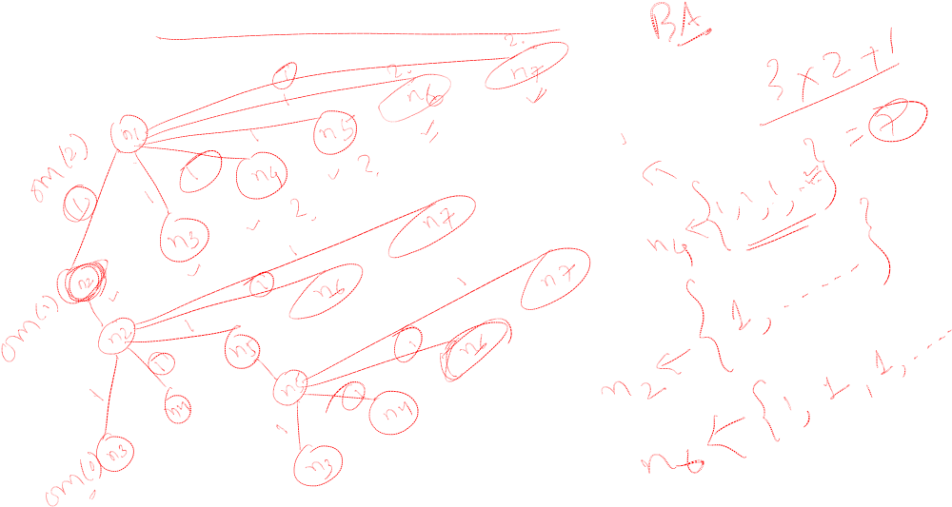
Example: 7 generals with 2 traitors
Birla Institute of Technology and Science, Pilani (Deemed University)

Slide 11
Next session
Applications of BA
Birla Institute of Technology and Science, Pilani (Deemed University)

